Slide 1

Type 1 Diabetes SNP Portal
By Team Microsoft Edge

Slide 2

Introduction
Type 1 diabetes mellitus (T1D) is an autoimmune disorder that results in the loss of insulin-producing pancreatic beta cells in genetically predisposed individuals, ultimately resulting in insulin deficiency and hyperglycaemia. (Nyaga et al., 2018)
Genome-wide association studies (GWAS) have identified a large number of genetic variants, or SNPs (single nucleotide polymorphisms) that confer higher susceptibility to T1D mostly in the HLA system.
Other genetic loci (non-HLA )are believed to influence population-level risk for T1D, although it is poorly understood how these contribute to disease susceptibility (Ram et al., 2016).

Slide 3
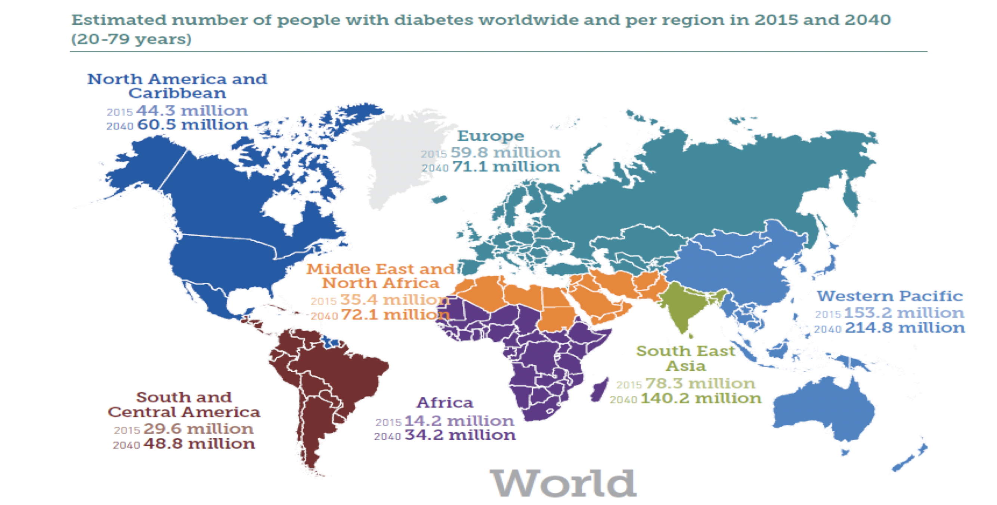
Global Burden of Diabetes
IDF Diabetes Atlas, 2015

Slide 4

Population
There is population level genetic variation that can be identified by analyses of microsatellite loci and the quantitative evaluation of allelic frequencies (Witherspoon et al., 2007).
Selected populations:
British
Han Chinese
Yoruba
Reasons:
Differences in T1D prevalence (low, medium and high) in the 3 populations.
Availabiity of data for each population
Effects of certain SNPs vary in these populations (Nyaga et al., 2018)

Slide 5
Project Significance
Rationale:
It is necessary to develop a web browser that leverages upon all the genomic, functional, and clinical information that properly interprets the mapping of the genetic basis of T1D.
Aims:
To build a web application that can retrieve genomic information of variants from all known associations to T1D and integrate them with population and functional information.
To produce informative plots and analyses using variant information.

Slide 6

Methods
Data Analysis
Website Frontend
Website Backend
Data Collection
Website Design
Planning
Manhattan & LD
Database Development & Functionality
Data Sources
Software Architecture

Slide 7
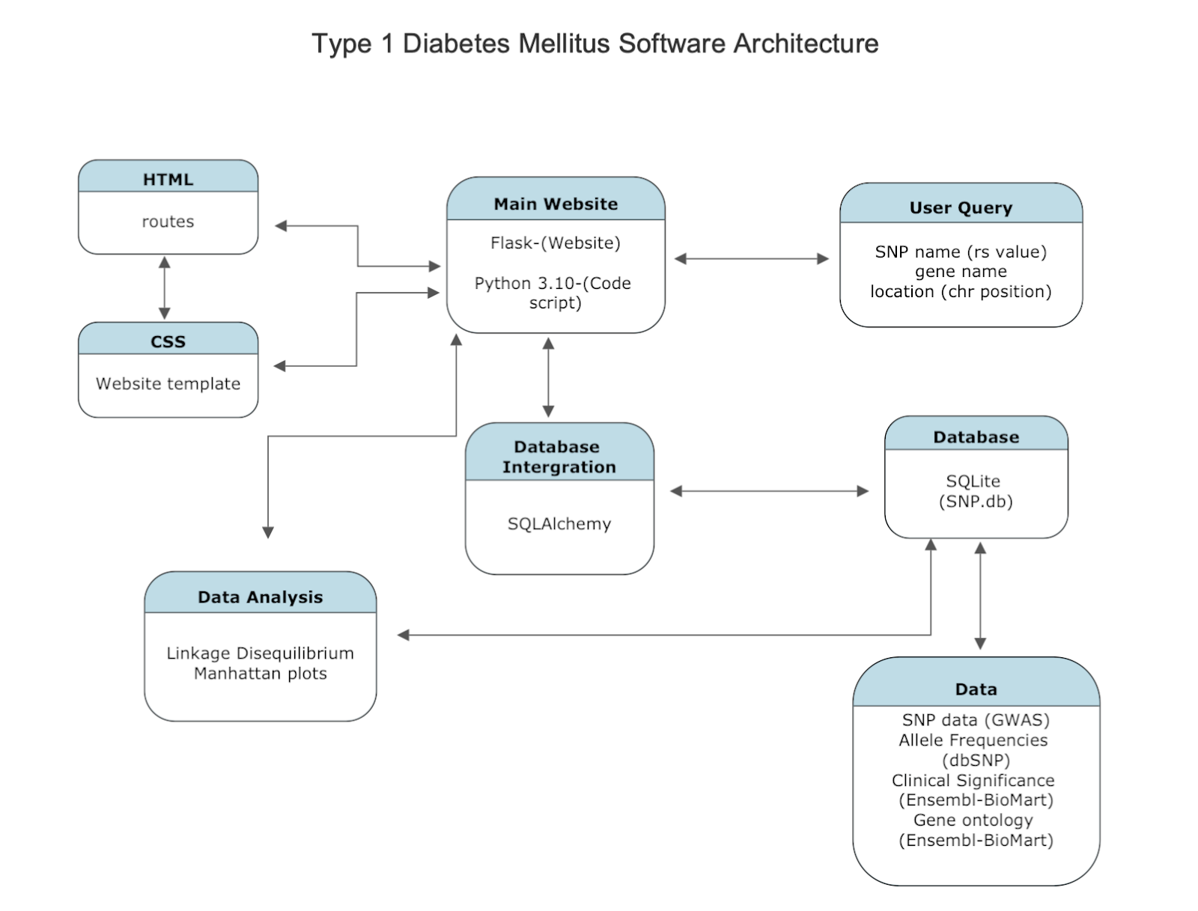
Software Architecture

Slide 8
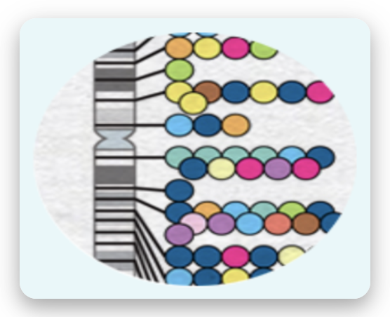



Data Sources
Variant information (SNPs)
GWAS Catalog:
Snp name
Risk Allele
Mapped genes
p-values
Chromosome location
Gene Ontology data
Ensembl:
Go term
Go domain
Go definition
Go term accession
GO Resource:
Missing data
Clinical/ Functional data
Ensembl:
Variant Consequence
Clinical Significance
Polyphen prediction
Polyphen Score
SIFT prediction
SIFT score
Allele Frequencies
Ensembl:
RAF per population
LD link:
Linkage Disequilibrium values

Slide 9
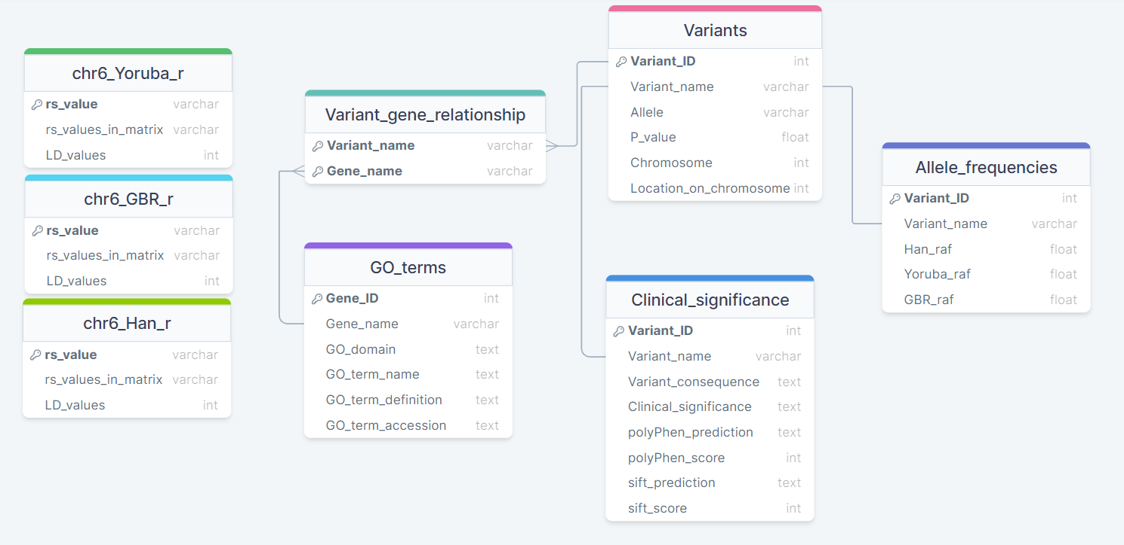
Database Schema

Slide 10
Website Backend
Database creation:
Sqlite3 was used to produce a locally saved DB
SQLAlchemy ORM was then used to access this in Flask
Python files were created for different tasks:
app.py is responsible for creating a flask instance and connecting this to our SQLAlchemy database
db_init.py initialises the SQLAlchemy database and creates a session to connect to it
models.py contains all of the ORM classes
main.py contains all of the routes for the website
functions.py contains all of the search functionality as functions in a separate file

Slide 11
Data Analysis Manhattan plot
Definition:
Shows the negative log p-values plotted by chromosome position
Method:
Interactive plot using R package “manhattanly”
Required data wrangling to get the data in the format required for manhattanly
Used python to call the R function using “rpy2”
Plot is saved as a html file which is then linked to the website

Slide 12
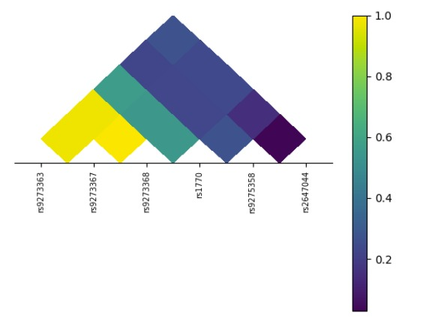
Data Analysis Linkage Disequilibrium
Linkage disequilibrium (LD) describes the degree to which one genetic variant is associated/correlated in terms of Inheritance with another genetic variant within a given population.
Plotting the relationship between variants
is done using a form of a heatmap.
This can help visualise the relationship
between two variants.
The LD Plot in this case was produced using
the “ld_plot” function in python (>3.6).

Slide 13
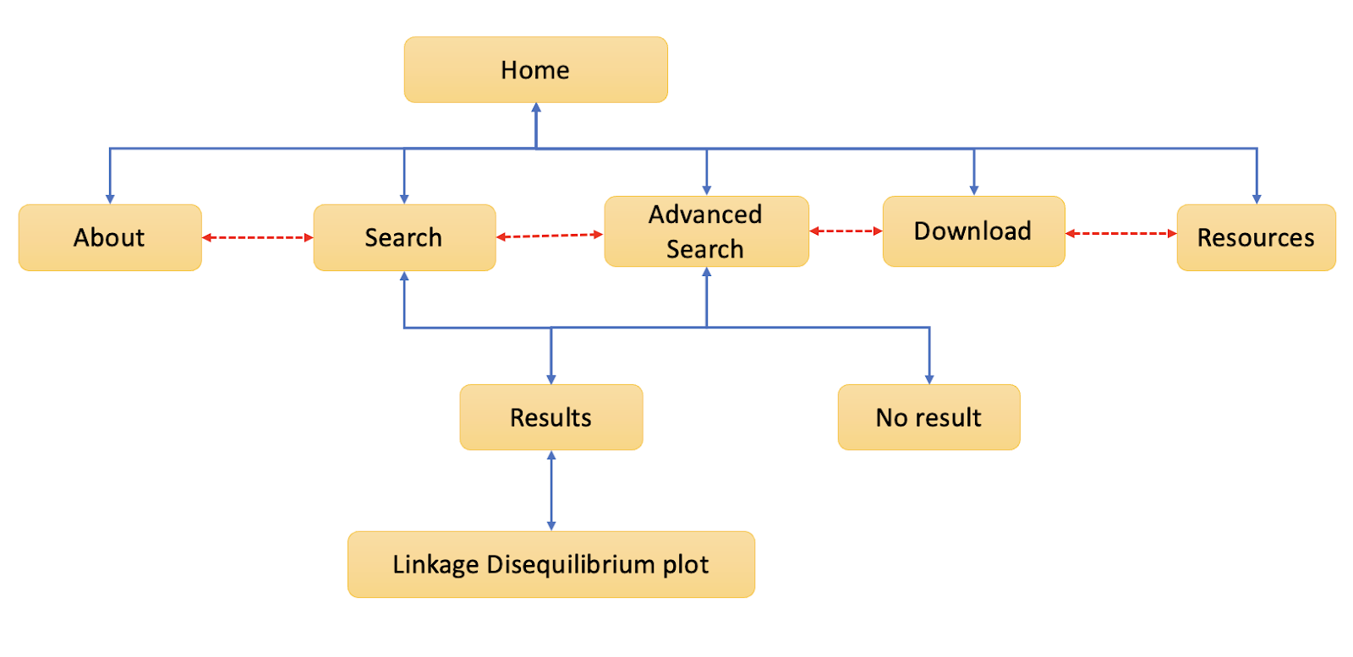
Website Frontend Overview

Slide 14
Website Demo

Slide 15
Limitations & Recommendations
Limitations :
Scarce functional and clinical SNP data
No API solution for linkage disequilibrium data (LD limited to chr6)
Recommendations:
Use application programming Interface (API)
Using WTForms to create a search bar instead of current method
Finding a neater method to serialize the objects returned by SQLAlchemy

Slide 16
Conclusion
AIM 1:
We were able to successfully develop a website that returns relevant SNP data from known associations to T1D.
AIM 2:
We also produced informative plots and analyses using variant information that are possibly useful for diabetes research.

Slide 17
References
Nyaga DM, Vickers MH, Jefferies C, Perry JK, O'Sullivan JM. The genetic architecture of type 1 diabetes mellitus. Mol Cell Endocrinol. 2018 Dec 5;477:70-80. doi: 10.1016/j.mce.2018.06.002. Epub 2018 Jun 18. PMID: 29913182.
Ramesh Ram, Munish Mehta, Quang T. Nguyen, Irma Larma, Bernhard O. Boehm, Flemming Pociot, Patrick Concannon, Grant Morahan; Systematic Evaluation of Genes and Genetic Variants Associated with Type 1 Diabetes Susceptibility. J Immunol 1 April 2016; 196 (7): 3043–3053. https://doi.org/10.4049/jimmunol.1502056
D J Witherspoon, S Wooding, A R Rogers, E E Marchani, W S Watkins, M A Batzer, L B Jorde, Genetic Similarities Within and Between Human Populations, Genetics, Volume 176, Issue 1, 1 May 2007, Pages 351–359, https://doi.org/10.1534/genetics.106.067355

Slide 18




Team Microsoft Edge
01
Fatema Hajizadah
Alexandre E. Fraser
02
04
Peter Ulijaszek Scott
Lynnette N. Bhebhe
03

Slide 19



Acknowledgements
Superivisors:
Prof Conrad Bessant
Dr Matteo Fumagalli

Slide 20

Thank you

